Slide 1
InternshipStudio Internship for Ethical Hacking
TASK - 2

Slide 2
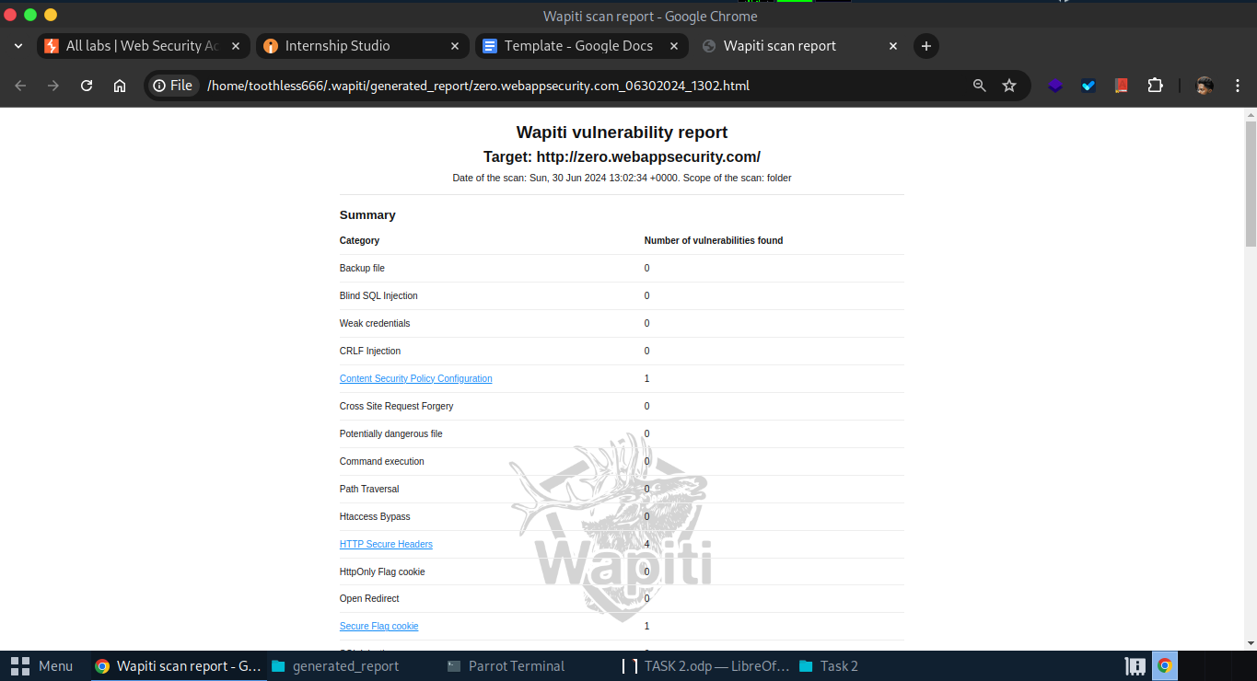
SCREENSHOT

Slide 3
HOW THE VULNERABILITY WAS DETECTED
In the above given image the vulnerabilities are highlighted in blue, from which the critical one is “HTTP Secure Headers Vulnerability”.
Here instead of using netsparker(tool not available as of now), the tool wapiti3 (an open source web application testing tool) in linux is used, which is run on the terminal. It scans the given website and finds the vulnerabilities on the web app.
Wapiti tool generates a report file in the local directory with the ‘.html’ extension.

Slide 4
REPORT
Vulnerability - “HTTP secure headers”:
The following vulnerabilities are been observed over the website:
“X-Frame-Options is not set”. A header which provides clickjacking protection by not allowing iframes to load on the website.
“X-XSS-Protection” is not set”. A header is designed to enables cross-site scripting (XSS) filter built into modern web browsers.
“X-Content-Type-Options is not set”. A header prevents Internet Explorer and Google Chrome from sniffing a response away from the declared Content-Type.
“Strict-Transport-Security is not set”. A header is a security enhancement that restricts web browsers to access web servers solely over HTTPS. This ensures connection cannot be establish through an insecure HTTP connection which could be susceptible to attacks.

Slide 5
THREAT
Since the Security Options and Protection is disabled, over the web app, this can lead to the sniffing attacks, mis-configurations compatability issues, clickjacking, Man-in-the-Middle attack, information disclosure, etc.
Anyone can hack the site and penetrate into the network and steal the credentials of the users which then can be used to exploit the user and do malicious activities.

Slide 6
SECURITY MEASURES
To mitigate the attacs on the headers, the proper configurations are needed, regular updates and testing, in depth defense and monitoring and logging.
One more security implementation can be done is setting up a honeypot in the network to monitor the malicious network activities early and prevent it.

